Slide 1
Is This Testable?
A Personal Journey to Learn How to Ask Better Questions from My Applications and Engineering Team
Michael Larsen Socialtext / PeopleFluent @mkltesthead

Slide 2
Play Along At Home!!!
This is a literal challenge everyone in this room can do.
This is a step by step process spelled out via Ministry of Testing and their “30 Days of Testability”.
This is an experience report of me putting in those 30 days and results that have followed on the six months after taking that challenge.
I am not a testability expert but I learned a lot doing this challenge.

Slide 3
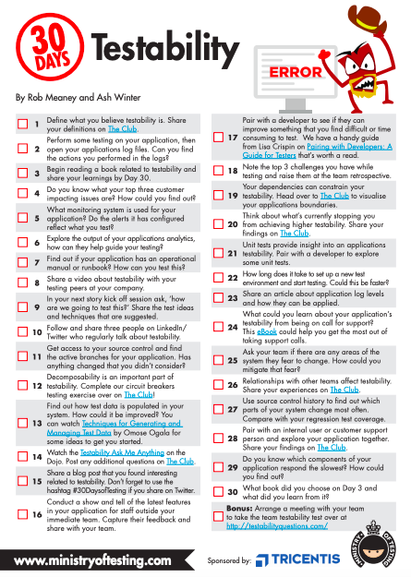
The 30 Days of Testability Challenge

Slide 4
Testability requires:
Communication
Involvement
A willingness to look at a product objectively and determine what would help make it more testable and, potentially, more usable by everyone.

Slide 5
Making Testability a Primary Focus
Formal Definition: ”The logical property that is variously described as contingency, defeasibility, or falsifiability, which means that counterexamples to the hypothesis are logically possible. The practical feasibility of observing a reproducible series of such counterexamples if they do exist.”

Slide 6
Making Testability a Primary Focus
My Definition: “A hypothesis is testable if there is some real possibility of deciding whether it is true or false based on real experience.”

Slide 7
Making Testability a Primary Focus
What is the goal of any test that we want to perform?
We want to determine if something can be proven correct or refuted.
Thus, we need to create conditions where a hypothesis can be either proven or refuted.
Regardless of the level of complexity of application, the goal is the same. We either confirm our hypothesis is correct or we prove our hypothesis is wrong.
If we cannot verify our hypothesis, then we must call into question the very methods which we will examine why it isn't going to work for us.

Slide 8
Getting Specific with Hypotheses Using Data
Example: Color Contrast Subjective: a light gray text over dark gray background doesn't provide a significant amount of color contrast.
Reasonable? Sure.
Testable? No, not really.

Slide 9
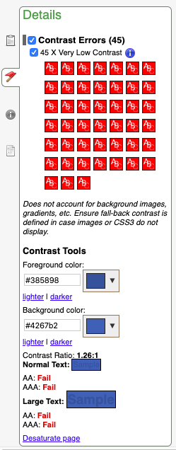
Getting Specific with Hypotheses Using Data
What's missing? Data.
Colors can be represented by hexadecimal values or RGB numerical values.
"These two colors look to be too close together" ... this is not a testable hypothesis. "These two colors have a contrast ratio of 1.26:1 and we are looking for a contrast ratio of 4.5:1 at the minimum" ... this is a testable hypothesis and it also contains data points to support it.

Slide 10
What Do Your Logs Say?
Log files show the history of events and actions that have taken place in a system. The sheer volume of information can also be overwhelming.
What is “the application” when discussing log files?
The actual application(s) I work with
The extended suite of applications that plug into ours
For each of the components that make up our application, there is a log file (or several) to examine.

Slide 11
What Do Your Logs Say?
There are logs for a number of aspects of our application and they are kept in separate files, such as: - installation and upgrades - authentication - component operations - third-party plug-ins - mail daemons - web server logs - search engine logs - etc. Looking in log files is a voyage of discovery.

Slide 12
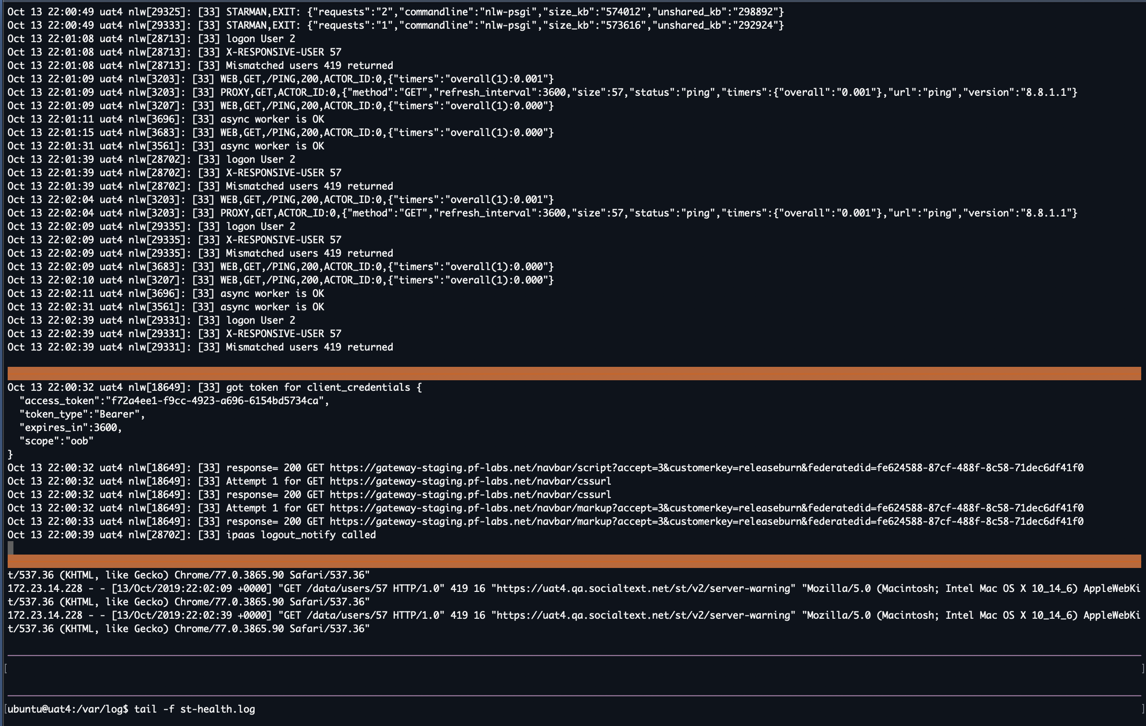
Use a simple screen multiplexers such as “screen”, “tmux” or “byobu”
Split a window into multiple fragments
Load all of your log files and monitor in real time.
I realize this is a “blinding flash of the obvious”.

Slide 13
Champion a Common Log Format (Where Possible)
For dogs we initialize and update, pick a format that can be easily parsed and compared. Example: - log_name: timestamp: alert_level: module: message
Gather all log files into an archive and have them archived each day (or whatever time option makes the most sense).
Make the messages put into the log files as human-readable as possible.

Slide 14
Identify a “Partner in Crime”
Example: Our Sales Engineer and I work closely together
We cloned our most active customer (and sanitized data).
We set up our test environment to match theirs in every aspect.
number of front-end servers
load balancing devices
back end servers
database replication schemes
customer accounts,
views to data and applications that we display through widgets in the application dashboard.

Slide 15
Using Feature Analytics
"What features in our product are our customers actually using?"
Customers have asked for specific features to be included in our application.
Range from “this would be nice to have” all the way to “if this feature is not included, we cannot purchase the product.”
How important are these requests really? How can we tell?
In app analytics that let us see what features are actually being used
what features requested are actually being adopted?
How many people actually rely on that “core piece of functionality? Are there a lot of them or are the few who are just loud?

Slide 16
“Does it make sense to keep a piece of functionality working the way that it is?”
We can make guesses but implementing feature analytics can give us data that we can them make actionable decisions about.

Slide 17
Automat-able Does Not Necessarily Mean Testable
“Automateable and Testable.” (Richardson, 2019).
Just because you can automate something doesn't necessarily means it's testable.
Automat-ability means that something else (a program, a shell script, or an API) can interact with it.
It doesn't necessarily mean that it's going to be a good experience for a user.
It also does not mean that the hypothesis related to the test will necessarily be proven or refuted.
"Testability is for humans. Automatability (Automatizability) is for applications.” (Richardson, 2019)

Slide 18
Example: Applications menu bar.
It is possible to click on the various elements and open other pages within the application. Those interactions can be automated.
However, those interactions give us no indication if that path makes the most sense or if the design of that interaction could be improved.
Can we navigate between the pages using nothing but a keyboard?
Based on traditional automation techniques, we may or may not know if that is true.

Slide 19
Testability can add a number of options to a program and can help to make a system more enjoyable/understandable for a user.
It may help with making an application more automat-able but it doesn't guarantee that it will.

Slide 20
“How Am I Going to Test This?”
Self evident, but important!
Stories get defined and features are determined during our story kickoff or design workshop.
It is my duty to ask, “how am I going to test this?” every time I am part of these meetings.

Slide 21
“How Am I Going to Test This?”
What might be the results of some of these questions?
add calls to the API so that I can query and set values without having to fire up a browser and look at a bunch of things on the screen.
create actual configuration enhancements of an application so that I can tweak various things while I'm setting up a test environment.
make sure that elements are named well (whenever possible) and that duplication is minimal
ensure that the error output is understandable

Slide 22
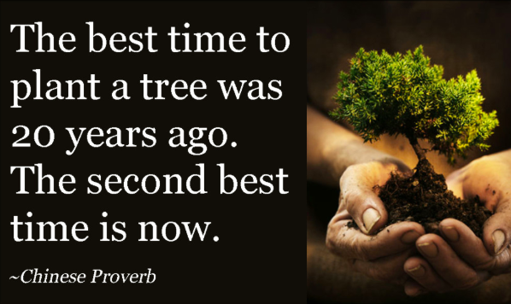
It is much easier to add a testing hook early in the process rather than later or as an afterthought.

Slide 23
Get a Handle on Your Test Data
In my product, everything is associated with an account, so often the most effective method to load test data (as well as to protect it and to use it from a known starting point) is to import an account that is already set up with the information I want to use.
Accounts created for:
Localization
Responsive Design
Accessibility & Inclusive Design
Large Customer simulation

Slide 24
Replicate components of our system:
Text examples
HTML and Markup formatting
Videos
Micro-App Interactions
Language preferences

Slide 25
Limit the use of test data that tries to be all things to all circumstances.
While it can be helpful to include a lot of details in one place, it can also complicate the situation in that there is "too much of a good thing” as well as too many variables to chase.

Slide 26
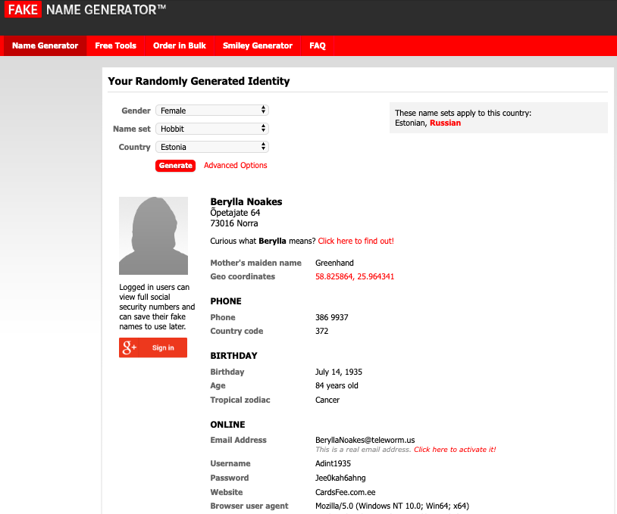
A favorite tool recommendation:
Fake Name Generator (https://fakenamegenerator.com)
Create rich, unique persona data that doesn’t repeat
Create a lot of it if desired (100,000 users at a time)

Slide 27
Conduct Regular “Show and Tell” Sessions
I’m the release manager/build manager for each of our releases.
One of my responsibilities has been to gather a cross-section of the broader engineering, sales, and support teams so that we can show them the new stuff going out with our next release.

Slide 28
Conduct Regular “Show and Tell” Sessions
As part of our "definition of done” we demo any feature we are working on to our product owner and/or our chief sales engineer.
This is a great time to walk through the feature, show as many parameters as we can and to listen to their questions.
Every once in a while, we have some deeper discussions that serve to point out that the new feature we are demonstrating may have some follow-on stories to consider.

Slide 29
Pair With Your Developers and Test Together
Common in my environment due to being a fully distributed team.
We work on unit tests and integration tests together, as well as spending time making sure we understand the scope of our issues.

Slide 30
"Pairing with Developers: A Guide for Testers" (Lisa Crispin, Ministry of Testing, 2019).
Key takeaways from Lisa’s article:
Have a specific goal for the session.
Block out a specific time interval.
Do the homework in advance.

Slide 31
Identify Your Dependencies
Most modern applications are not self-contained.
They rely on a variety of third-party or open source components to allow them to run, as well as external libraries and other dependencies that may not be clearly outlined.
Create a specific test environment with users that have permissions to access multiple connecting applications.

Slide 32
Check Your Source Control History and “Feel the Heat”
where are we making frequent changes?
What other components do those changes interact with?
The closer the level of interaction, the greater the level of “heat”.

Slide 33
Check Your Source Control History and “Feel the Heat”
By using our source control history, it is possible to find out which parts of our system change most often.
Example: Responsive Design
a lot of changes to our front end and how it is displayed with regard to the device or user agent making the calls.
New code interacts with components that effect older code and thus have an effect on how that legacy interface responds.
By looking at the source code changes and getting a feel for what has been modified, I can also determine which areas in our legacy interface might need to be looked at once again.

Slide 34
Conclusion
Identify areas that are potential issues
Be able to talk about them in a meaningful way with our development teams.
Look at our systems objectively and identify the areas we can test effectively first, so that we can better define and describe the areas that have deficiencies.

Slide 35
Conclusion
No easy fix to testability. The process is ongoing.
Requires focus and consistent communication.
With consistent effort and a willingness to keep asking questions, it will be possible to narrow down the areas where we have to ask “is this testable?” It may not be possible to make every area perfectly testable but we can certainly make our applications more testable over time and that is an outcome I think everyone would welcome.

Slide 36
Conclusion
No easy fix to testability. The process is ongoing.
Requires focus and consistent communication.
With consistent effort and a willingness to keep asking questions, it will be possible to narrow down the areas where we have to ask “is this testable?”
It may not be possible to make every area perfectly testable but we can certainly make our applications more testable over time and that is an outcome I think everyone would welcome.

Slide 37
Conclusion
It may not be possible to make every area perfectly testable but we can certainly make our applications more testable over time and that is an outcome I think everyone would welcome.

Slide 38
References
Ministry of Testing. “Thirty Days of Testability”. Ministry of Testing, https://www.ministryoftesting.com/dojo/lessons/30-days-of-testability (accessed July 20, 2019).
Wikipedia. “Software Testability.” https://en.wikipedia.org/wiki/Software_testability (accessed July 20, 2019).
Alan Richardson. “Testability vs Automatability - in theory”. Evil Tester, https://www.eviltester.com/2018/01/testability-vs-automatability-in-theory.html (accessed July 20, 2019).
Fake Name Generator. https://www.fakenamegenerator.com/ (accessed July 20, 2019).
Crispin, Lisa. “Pairing With Developers: A Guide For Testers”. Ministry of Testing. https://www.ministryoftesting.com/dojo/lessons/pairing-with-developers-a-guide-for-testers (accessed July 20, 2019).

